Slide 1
ENEL 419
STATISTICS: Estimation
(Reading Exercises: Montgomery and Runger – Chapter 7)
(Reading Exercises: Yates and Goodman – Chapter 10)

Slide 2
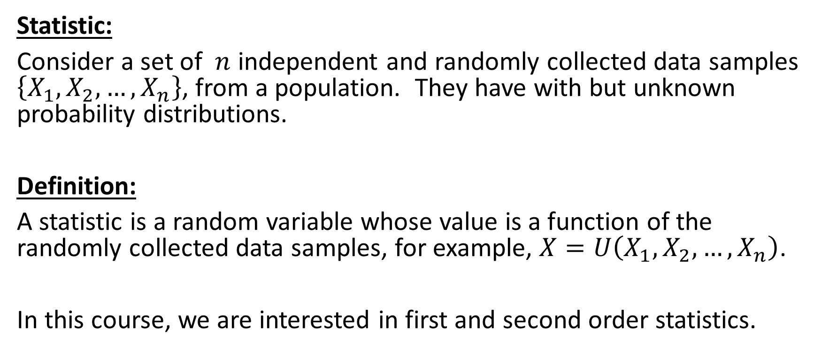
Statistics and their Distributions
Statistic:
Consider a set of $n$ independent and randomly collected data samples $\left\{X_{1}, X_{2}, …, X_{n}\right\}$, from a population. They have with but unknown probability distributions.
Definition:
A statistic is a random variable whose value is a function of the randomly collected data samples, for example, $X=U\left(X_{1}, X_{2}, …, X_{n}\right)$.
In this course, we are interested in first and second order statistics.

Slide 3
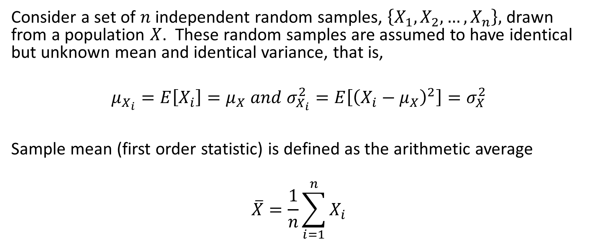
Sample Mean – First order statistic
Consider a set of $n$ independent random samples, $\left\{X_{1}, X_{2}, …, X_{n}\right\},$ drawn from a population $X$. These random samples are assumed to have identical but unknown mean and identical variance, that is,
$$μ_{X_{i}}=E\left[X_{i}\right]=μ_{X} and{ σ}_{X_{i}}^{2}=E\left[{\left(X_{i}−μ_{X}\right)}^{2}\right]=σ_{X}^{2}$$
Sample mean (first order statistic) is defined as the arithmetic average
$$\overline{X}=\frac{1}{n}\sum_{i=1}^{n}{X_{i}}$$

Slide 4
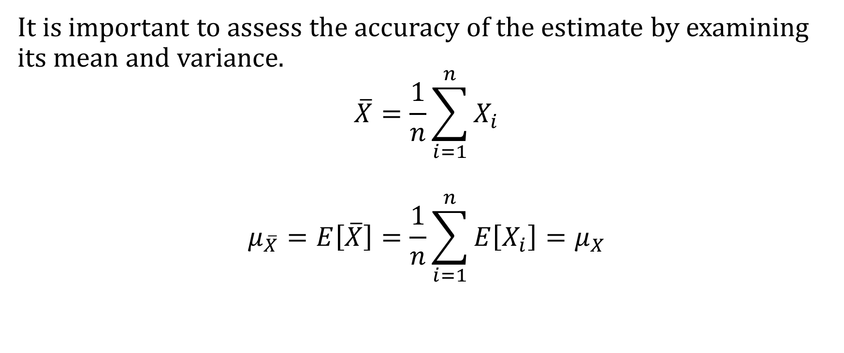
Mean of Sample Mean
It is important to assess the accuracy of the estimate by examining its mean and variance.
$$\overline{X}=\frac{1}{n}\sum_{i=1}^{n}{X_{i}}$$
$$μ_{\overline{X}}=E\left[\overline{X}\right]=\frac{1}{n}\sum_{i=1}^{n}{E\left[X_{i}\right]}=μ_{X}$$

Slide 5
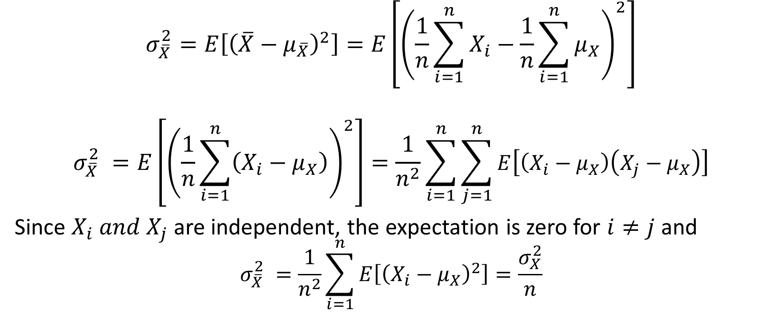
Variance of Sample Mean
$$σ_{\overline{X}}^{2}=E\left[{\left(\overline{X}−μ_{\overline{X}}\right)}^{2}\right]=E\left[{\left(\frac{1}{n}\sum_{i=1}^{n}{X_{i}−\frac{1}{n}\sum_{i=1}^{n}{μ_{X}}}\right)}^{2}\right]$$
$$σ_{\overline{X}}^{2} =E\left[{\left(\frac{1}{n}\sum_{i=1}^{n}{\left(X_{i}−μ_{X}\right)}\right)}^{2}\right]=\frac{1}{n^{2}}\sum_{i=1}^{n}{\sum_{j=1}^{n}{E\left[\left(X_{i}−μ_{X}\right)\left(X_{j}−μ_{X}\right)\right]}}$$
Since $X_{i} and X_{j}$ are independent, the expectation is zero for $i≠j$ and
$$σ_{\overline{X}}^{2} =\frac{1}{n^{2}}\sum_{i=1}^{n}{E\left[{\left(X_{i}−μ_{X}\right)}^{2}\right]}=\frac{σ_{X}^{2}}{n}$$

Slide 6
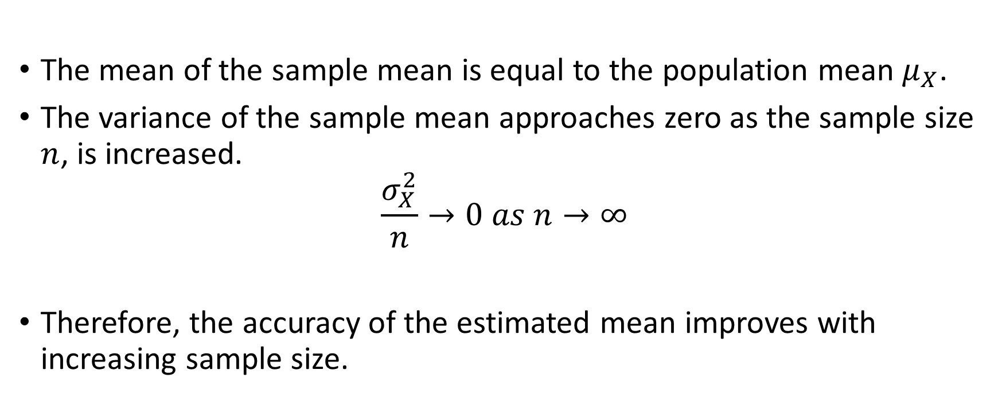
Conclusions
The mean of the sample mean is equal to the population mean $μ_{X}$.
The variance of the sample mean approaches zero as the sample size $n$, is increased.
$$\frac{σ_{X}^{2}}{n}→0 as n→∞$$
Therefore, the accuracy of the estimated mean improves with increasing sample size.

Slide 7
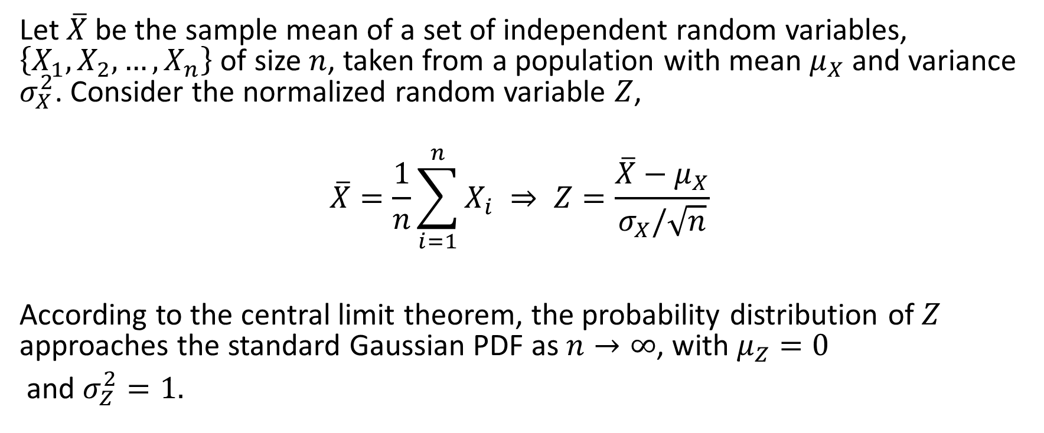
Central Limit Theorem
Let $\overline{X}$ be the sample mean of a set of independent random variables, $\left\{X_{1}, X_{2}, …, X_{n}\right\}$ of size $n$, taken from a population with mean $μ_{X}$ and variance $σ_{X}^{2}$. Consider the normalized random variable $Z$,
$$\overline{X}=\frac{1}{n}\sum_{i=1}^{n}{X_{i}} ⇒ Z=\frac{\overline{X}−μ_{X}}{σ_{X}/\sqrt{n}}$$
According to the central limit theorem, the probability distribution of $Z$ approaches the standard Gaussian PDF as $n→∞$, with $μ_{Z}=0$
and $σ_{Z}^{2}=1.$

Slide 8

Example 1
It is required to infer whether the population of resistors from a production line is within a tolerance range $1000Ω±10\%$ . We pick a random sample of $10$ resistors and measure their resistances in ohms, which are provided in the table below

Slide 9
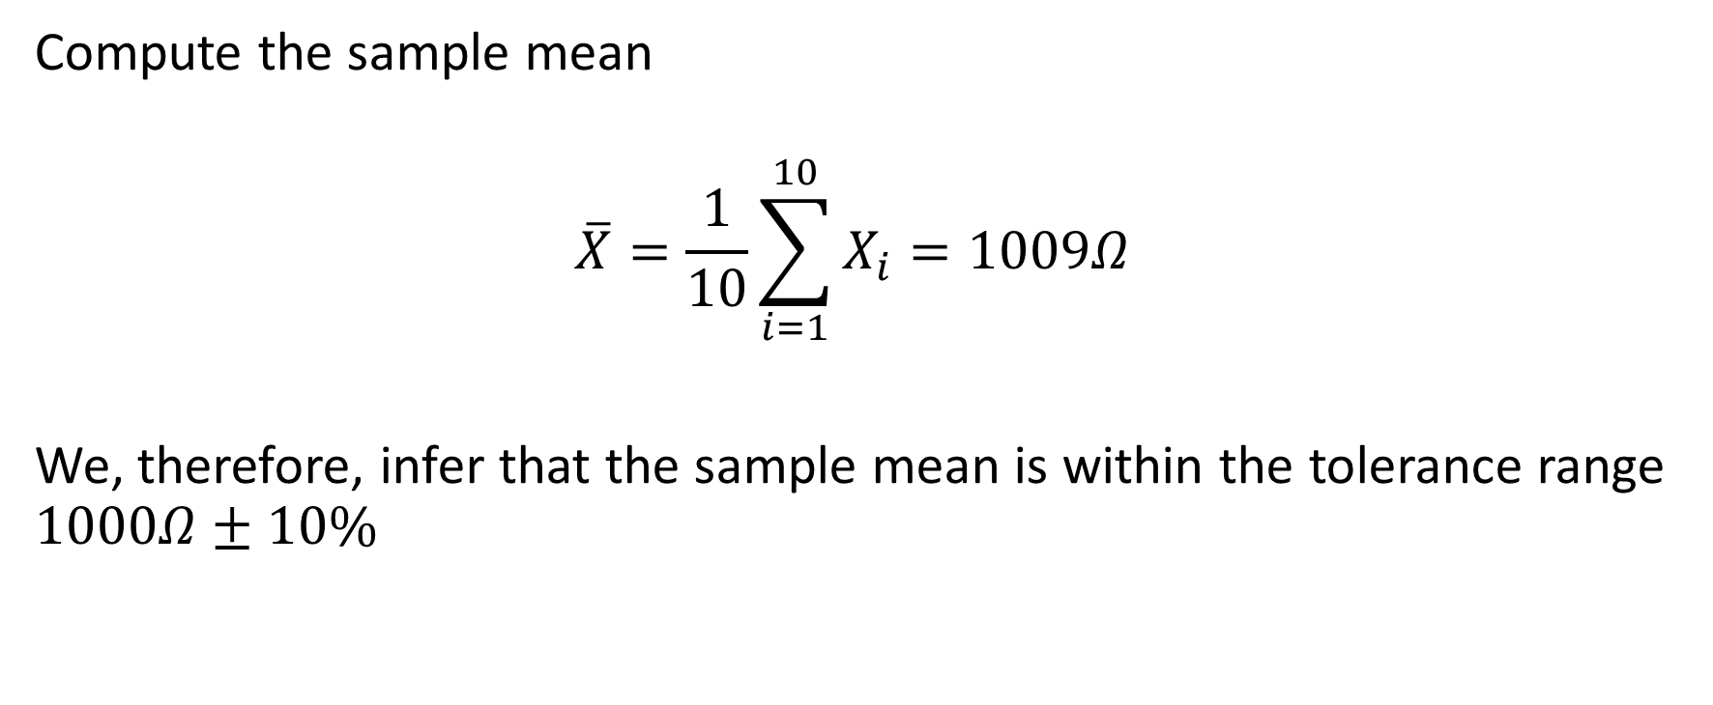
Example 1 Solution
Compute the sample mean
$$\overline{X}=\frac{1}{10}\sum_{i=1}^{10}{X_{i}=1009Ω}$$
We, therefore, infer that the sample mean is within the tolerance range $1000Ω±10\%$

Slide 10
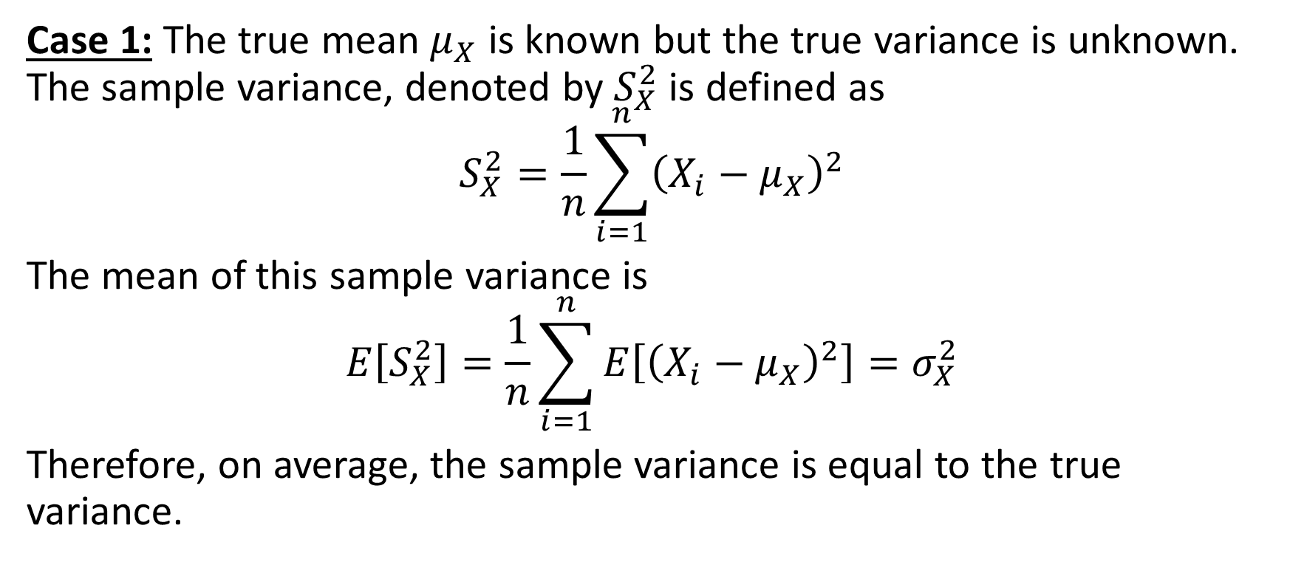
Sample Variance
Case 1: The true mean $μ_{X}$ is known but the true variance is unknown. The sample variance, denoted by $S_{X}^{2}$ is defined as
$$S_{X}^{2}=\frac{1}{n}\sum_{i=1}^{n}{{\left(X_{i}−μ_{X}\right)}^{2}}$$
The mean of this sample variance is
$$E\left[S_{X}^{2}\right]=\frac{1}{n}\sum_{i=1}^{n}{E\left[{\left(X_{i}−μ_{X}\right)}^{2}\right]}=σ_{X}^{2}$$
Therefore, on average, the sample variance is equal to the true variance.

Slide 11
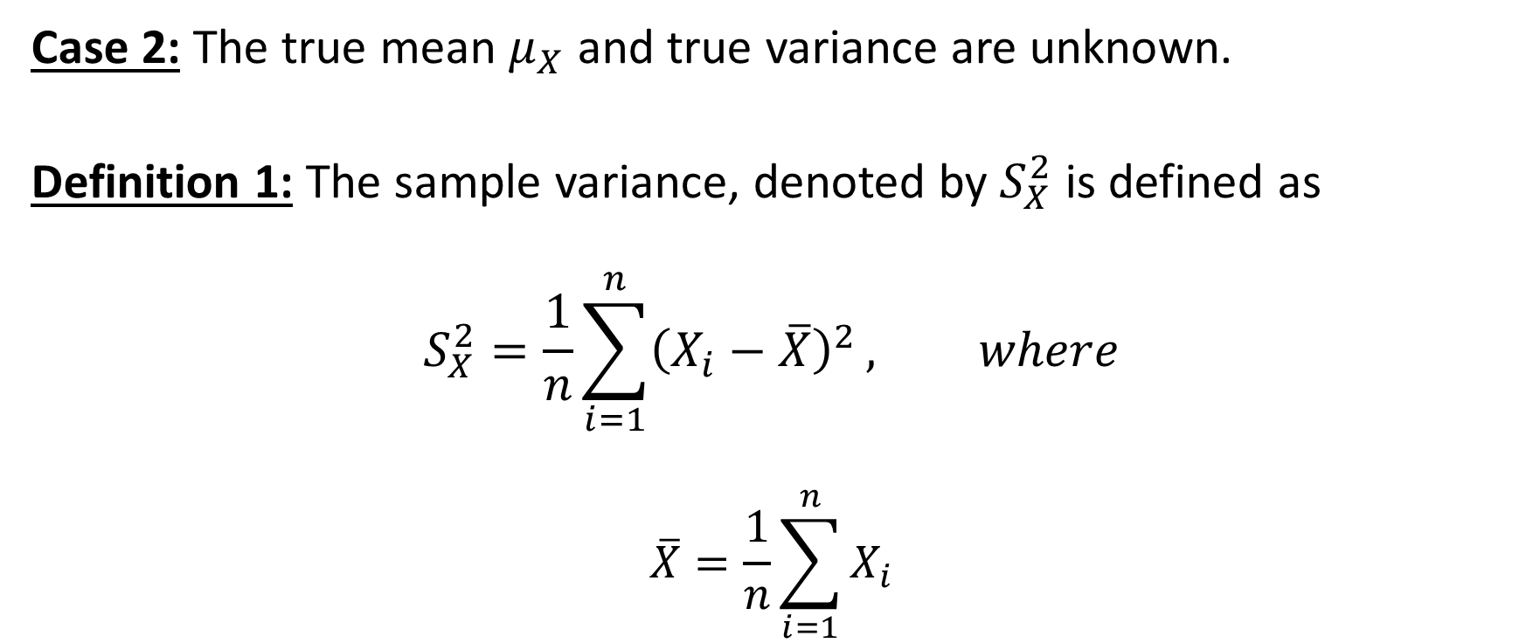
Sample Variance
Case 2: The true mean $μ_{X}$ and true variance are unknown.
Definition 1: The sample variance, denoted by $S_{X}^{2}$ is defined as
$$S_{X}^{2}=\frac{1}{n}\sum_{i=1}^{n}{{\left(X_{i}−\overline{X}\right)}^{2}}, where$$
$$\overline{X}=\frac{1}{n}\sum_{i=1}^{n}{X_{i}}$$

Slide 12
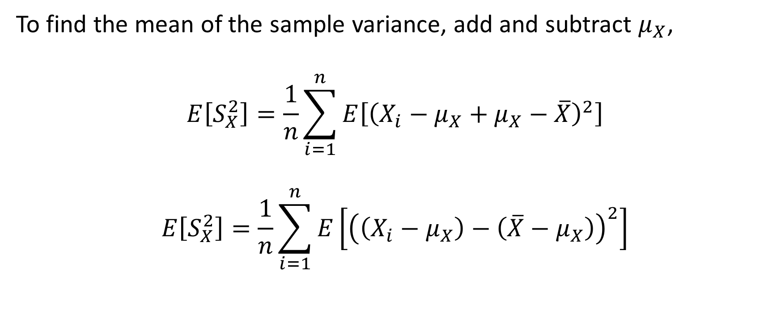
Mean of Sample Variance
To find the mean of the sample variance, add and subtract $μ_{X}$,
$$E\left[S_{X}^{2}\right]=\frac{1}{n}\sum_{i=1}^{n}{E\left[{\left(X_{i}−μ_{X}+μ_{X}−\overline{X}\right)}^{2}\right]}$$
$$E\left[S_{X}^{2}\right]=\frac{1}{n}\sum_{i=1}^{n}{E\left[{\left(\left(X_{i}−μ_{X}\right)−\left({\overline{X}−μ}_{X}\right)\right)}^{2}\right]}$$

Slide 13

Mean of Sample Variance
Simplify and take the mean term by term
$E\left[S_{X}^{2}\right]= \frac{1}{n}\sum_{i=1}^{n}{E\left[{\left(X_{i}−μ_{X}\right)}^{2}\right]}−2E\left[{\left({\overline{X}−μ}_{X}\right)}^{2}\right]$+ $E\left[{\left({\overline{X}−μ}_{X}\right)}^{2}\right]$

Slide 14

Mean of Sample Variance
$$\frac{1}{n}\sum_{i=1}^{n}{E\left[{\left(X_{i}−μ_{X}\right)}^{2}\right]=}σ_{X}^{2} (from slide \#10)$$
$$E\left[{\left({\overline{X}−μ}_{X}\right)}^{2}\right]=\frac{σ_{X}^{2}}{n}, (from slide \#5)$$
Therefore,
$E\left[S_{X}^{2}\right]=$ $σ_{X}^{2}−2\frac{σ_{X}^{2}}{n}+\frac{σ_{X}^{2}}{n}=\frac{n−1}{n}σ_{X}^{2}$

Slide 15
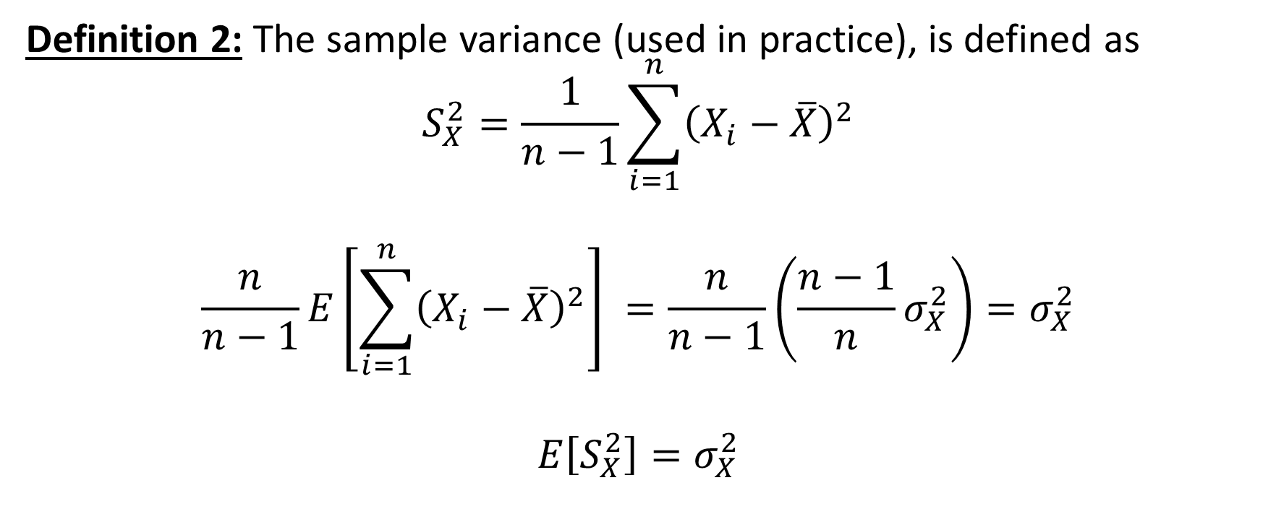
Mean of Sample Variance
Definition 2: The sample variance (used in practice), is defined as
$$S_{X}^{2}=\frac{1}{n−1}\sum_{i=1}^{n}{{\left(X_{i}−\overline{X}\right)}^{2}}$$
$$\frac{n}{n−1}E\left[\sum_{i=1}^{n}{{\left(X_{i}−\overline{X}\right)}^{2}}\right] =\frac{n}{n−1}\left(\frac{n−1}{n}σ_{X}^{2}\right)=σ_{X}^{2}$$
$$E\left[S_{X}^{2}\right]=σ_{X}^{2}$$

Slide 16
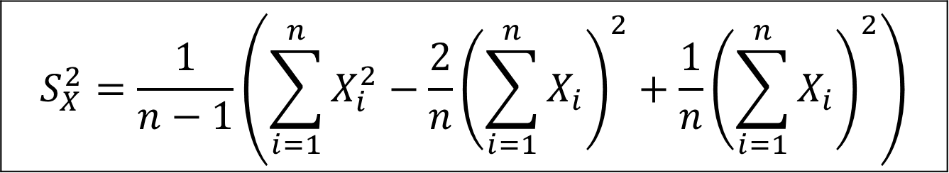

Short-Cut Formula for Sample Variance
$$S_{X}^{2}=\frac{1}{n−1}\sum_{i=1}^{n}{{\left(X_{i}−\overline{X}\right)}^{2}}=\frac{1}{n−1}\left(\sum_{i=1}^{n}{X_{i}^{2}}−2\sum_{i=1}^{n}{X_{i}\overline{X}+}\sum_{i=1}^{n}{{\overline{X}}^{2}}\right)$$
$$S_{X}^{2}=\frac{1}{n−1}\left(\sum_{i=1}^{n}{X_{i}^{2}}−\frac{2}{n}{\left(\sum_{i=1}^{n}{X_{i}}\right)}^{2}+\frac{1}{n}{\left(\sum_{i=1}^{n}{X_{i}}\right)}^{2}\right)$$

Slide 17
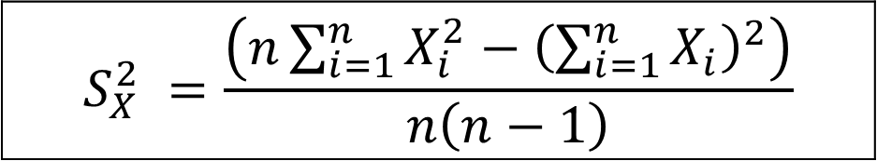

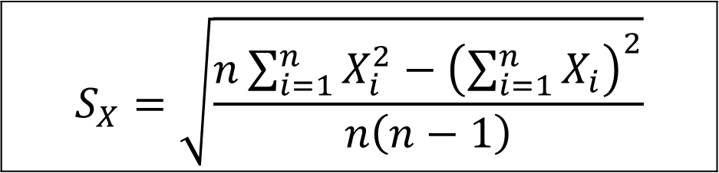
Short-Cut Formula for Sample Variance and Sample Standard Deviation
$$S_{X}^{2}=\frac{1}{n−1}\left(\sum_{i=1}^{n}{X_{i}^{2}}−\frac{1}{n}{\left(\sum_{i=1}^{n}{X_{i}}\right)}^{2}\right)$$
$$S_{X}^{2} =\frac{\left(n\sum_{i=1}^{n}{X_{i}^{2}}−{\left(\sum_{i=1}^{n}{X_{i}}\right)}^{2}\right)}{n\left(n−1\right)}$$
$$S_{X}=\sqrt{\frac{n\sum_{i=1}^{n}{X_{i}^{2}}−{\left(\sum_{i=1}^{n}{X_{i}}\right)}^{2}}{n\left(n−1\right)}}$$

Slide 18
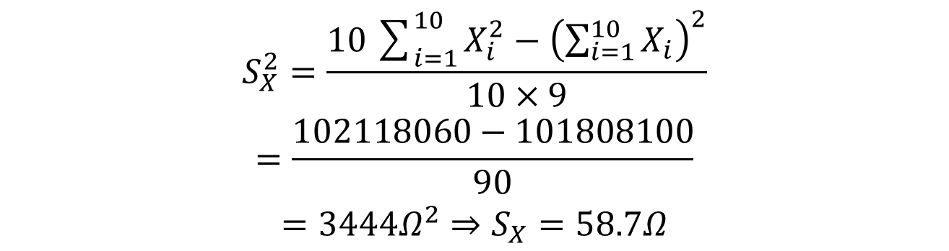
Example 2
Find the sample variance and sample standard deviation for the data samples in the table below.
$$\begin{matrix}S_{X}^{2}=\frac{10\sum_{i=1}^{10}{X_{i}^{2}}−{\left(\sum_{i=1}^{10}{X_{i}}\right)}^{2}}{10×9} \\ =\frac{102118060−101808100}{90} \\ =3444Ω^{2}⇒S_{X}=58.7Ω\end{matrix}$$

Slide 19
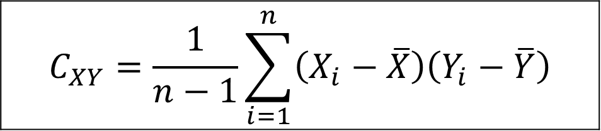
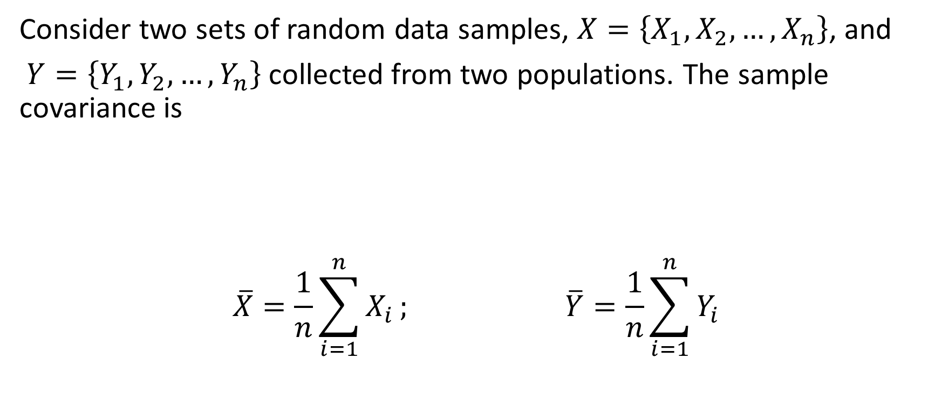
Sample Covariance and Correlation Coefficient
Consider two sets of random data samples, $X=\left\{X_{1}, X_{2}, …, X_{n}\right\}$, and
$Y=\left\{Y_{1}, Y_{2}, …, Y_{n}\right\}$collected from two populations. The sample covariance is
$$\overline{X}=\frac{1}{n}\sum_{i=1}^{n}{X_{i}}; \overline{Y}=\frac{1}{n}\sum_{i=1}^{n}{Y_{i}}$$
$$C_{XY}=\frac{1}{n−1}\sum_{i=1}^{n}{\left(X_{i}−\overline{X}\right)\left(Y_{i}−\overline{Y}\right)}$$

Slide 20
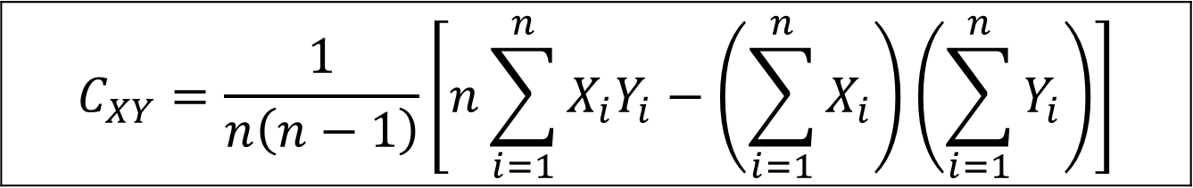
Short-Cut Formula for Sample Covariance
$$C_{XY}=\frac{1}{n\left(n−1\right)}\left[n\sum_{i=1}^{n}{X_{i}Y_{i}−\left(\sum_{i=1}^{n}{X_{i}}\right)\left(\sum_{i=1}^{n}{Y_{i}}\right)}\right]$$

Slide 21

Sample Correlation Coefficient
$$ρ_{XY}=\frac{C_{XY}}{S_{X}S_{Y}}$$
$$S_{X}=\sqrt{\frac{1}{n−1}\sum_{i=1}^{n}{{\left(X_{i}−\overline{X}\right)}^{2}}}$$
$$S_{Y}=\sqrt{\frac{1}{n−1}\sum_{i=1}^{n}{{\left(Y_{i}−\overline{Y}\right)}^{2}}}$$

Slide 22

Properties of Correlation Coefficient
$−1≤ρ_{XY}≤+1$
If $ρ_{XY}=0,$ then $X and Y$ are uncorrelated or independent.
If $ρ_{XY}≠0$, then $X and Y$ are correlated or linearly related.

Slide 23

Example 3
Find the correlation coefficient for the data pairs in the table below.
Solution:
$$\begin{matrix}\overline{X}=\frac{1}{10}\sum_{i=1}^{10}{X_{i}}=2.6, & \end{matrix}$$
$$\overline{Y}=\frac{1}{10}\sum_{i=1}^{10}{Y_{i}}=12.44$$

Slide 24
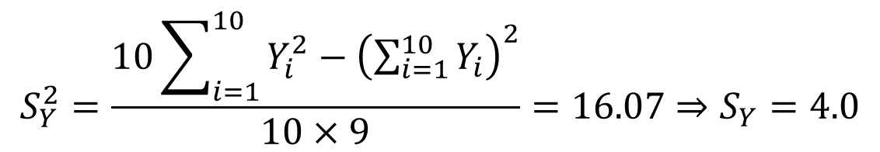
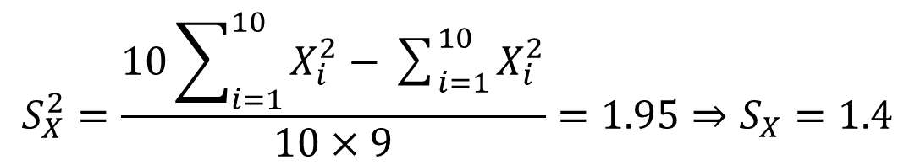
Example 3 Solution
$$S_{X}^{2}=\frac{10\sum_{i=1}^{10}{X_{i}^{2}−\sum_{i=1}^{10}{X_{i}^{2}}}}{10×9}=1.95⇒S_{X}=1.4$$
$$S_{Y}^{2}=\frac{10\sum_{i=1}^{10}{Y_{i}^{2}−{\left(\sum_{i=1}^{10}{Y_{i}}\right)}^{2}}}{10×9}=16.07⇒S_{Y}=4.0$$

Slide 25
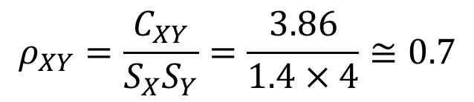

Example 3 Solution
$$C_{XY}=\frac{10\sum_{i=1}^{10}{X_{i}Y_{i}}−\sum_{i=1}^{10}{X_{i}}\sum_{i=1}^{10}{Y_{i}}}{10×9}=3.86$$
Conclusion:
There is a strong correlation between the two populations
$$ρ_{XY}=\frac{C_{XY}}{S_{X}S_{Y}}=\frac{3.86}{1.4×4}≅0.7$$

Slide 26

Example 4
An electrical firm manufactures light bulbs that have a mean length of life equal to $800 hours$ and a standard deviation of $40 hours$. Find the probability that a random sample of $16$ bulbs will have an average life of less than $775$ hours.

Slide 27

Example 4 Solution
If we take $16$ random samples, the distribution of $\overline{X}$ will be approximately Gaussian, with sample mean $μ_{\overline{X}}=μ_{X}=800$ and sample standard deviation
$$σ_{\overline{X}}=\frac{40}{\sqrt{16}}=10$$

Slide 28
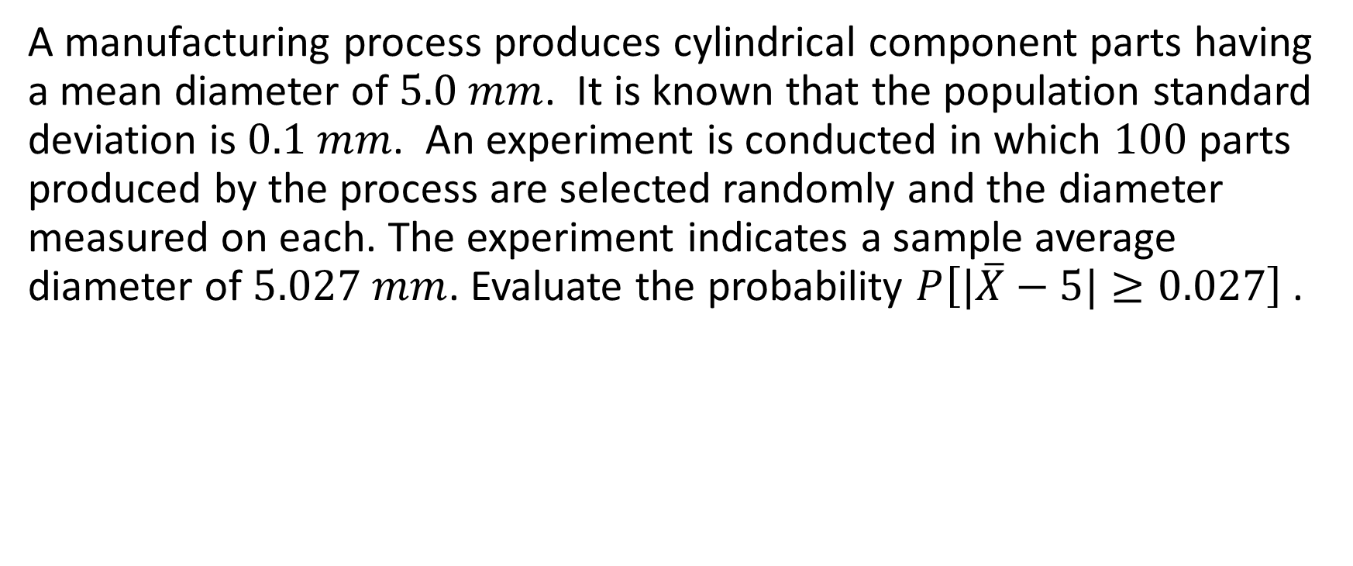
Example 5
A manufacturing process produces cylindrical component parts having a mean diameter of $5.0 mm$. It is known that the population standard deviation is $0.1 mm$. An experiment is conducted in which $100$ parts produced by the process are selected randomly and the diameter measured on each. The experiment indicates a sample average diameter of $5.027 mm$. Evaluate the probability $P\left[|\overline{X}−5|≥0.027\right]$ .

Slide 29
Example 5 Solution

Slide 30
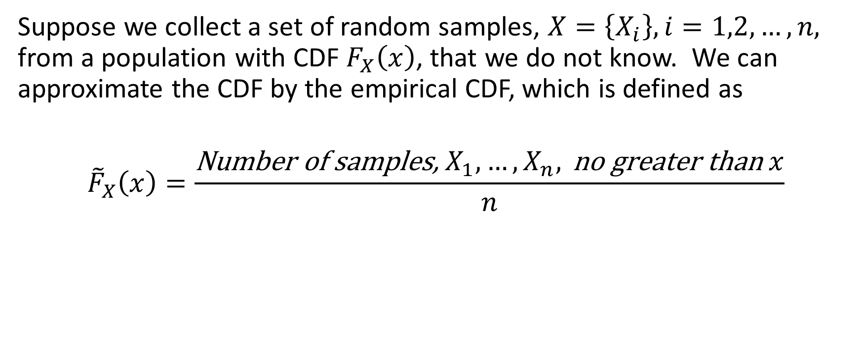
Empirical Distribution Functions
Suppose we collect a set of random samples, $X=\left\{X_{i}\right\}, i=1,2,…,n,$ from a population with CDF $F_{X}\left(x\right)$, that we do not know. We can approximate the CDF by the empirical CDF, which is defined as
$${\tilde{F}}_{X}\left(x\right)=\frac{\text{Number} \text{of} \text{samples}\text{, }X_{1},…,X_{n}, \text{no} \text{greater} \text{than} x}{n}$$

Slide 31
Example 6
Determine the empirical CDF of the resistance samples in the table below.
Solution: First, we need to list the samples in ascending order,

Slide 32
Example 6 Solution
The empirical CDF is shown in the table below,

Slide 33
Monte Carlo Simulations
A Monte Carlo simulation is a method for carrying out complex computer simulations of systems undergoing random perturbations. Suppose we have a system described in terms of input-output equations. The input or system parameters have random aspects (random noise, unknown component values, etc.). We can obtain a probabilistic description of the system by modeling the random quantities with random number generators on a computer, repeatedly solving the system equations as we draw different realizations for the random quantities and computing some statistics of the desired responses or outputs.

Slide 34
System Model for Monte Carlo Simulations

